Slide 1
State of Water: Minnesota’s Lakes, Rivers and Wetlands
John Jaschke
Minnesota Board of Water and Soil Resources
Nov 13, 2014

Slide 2
BWSR mission: Improve and protect Minnesota's water and soil resources by working in partnership with local organizations and private landowners
BWSR focus: on-the-ground conservation and clean water results

Slide 3
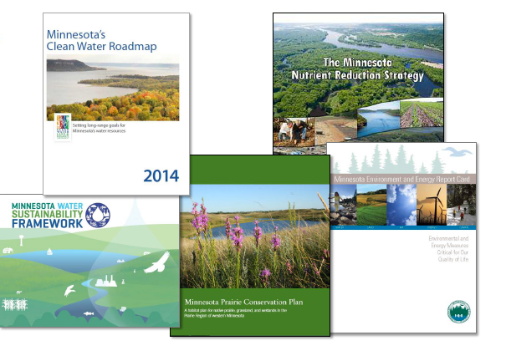
We know what to do
Notes:
Counties, with their planning and land-use authorities, are uniquely positioned to link land-use decisions with local water management goals. Chisago County is home to the Chisago Chain of Lakes, over 6,000 acres of water, miles of shoreline to explore; a destination for outdoor enthusiasts to fish, boat and swim. Phosphorus pollution is an issue in the region, with its annual telltale algal blooms that affect both plant and animal life. The Chisago County Local Water Management Plan (2010-2013) specifies a 20% reduction in phosphorus by 2020. Since 2011, 6 CWF grants have been awarded to accelerate work in the area by inventorying and identifying critical areas, installing over 60 conservation practices to bring them to 5% achievement of their goal.

Slide 4
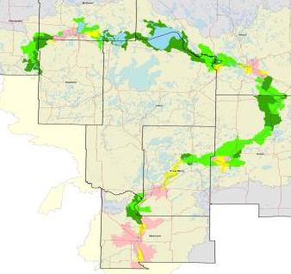
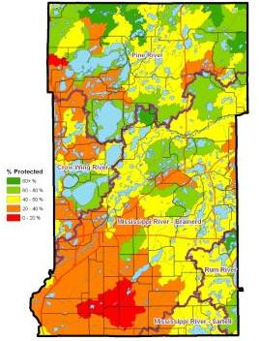
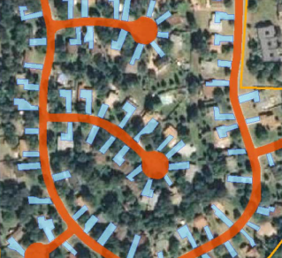

We know where to target:
Local Water Management Plans
Notes:
Counties, with their planning and land-use authorities, are uniquely positioned to link land-use decisions with local water management goals. Chisago County is home to the Chisago Chain of Lakes, over 6,000 acres of water, miles of shoreline to explore; a destination for outdoor enthusiasts to fish, boat and swim. Phosphorus pollution is an issue in the region, with its annual telltale algal blooms that affect both plant and animal life. The Chisago County Local Water Management Plan (2010-2013) specifies a 20% reduction in phosphorus by 2020. Since 2011, 6 CWF grants have been awarded to accelerate work in the area by inventorying and identifying critical areas, installing over 60 conservation practices to bring them to 5% achievement of their goal.

Slide 5
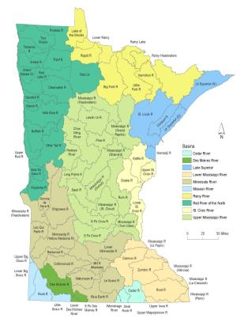
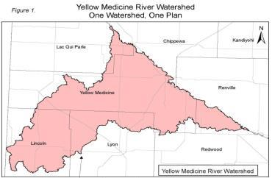
Watershed Management
Notes:
Counties, with their planning and land-use authorities, are uniquely positioned to link land-use decisions with local water management goals. Chisago County is home to the Chisago Chain of Lakes, over 6,000 acres of water, miles of shoreline to explore; a destination for outdoor enthusiasts to fish, boat and swim. Phosphorus pollution is an issue in the region, with its annual telltale algal blooms that affect both plant and animal life. The Chisago County Local Water Management Plan (2010-2013) specifies a 20% reduction in phosphorus by 2020. Since 2011, 6 CWF grants have been awarded to accelerate work in the area by inventorying and identifying critical areas, installing over 60 conservation practices to bring them to 5% achievement of their goal.

Slide 6






Science-Based Conservation Investments:
Clean Water Fund
Clean Water Fund Interagency Coordination
Notes:
6

Slide 7
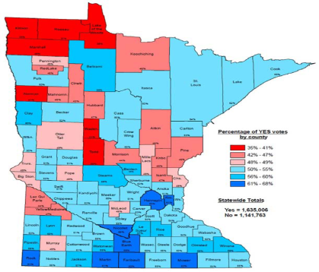
Dedicated Funding – Nov 2008
Question approved by voters:
“Shall the Minnesota Constitution be amended to dedicate funding to protect our drinking water sources; to protect, enhance, and restore our wetlands, prairies, forests, and fish, game, and wildlife habitat; to preserve our arts and cultural heritage; to support our parks and trails; and to protect, enhance, and restore our lakes, rivers, streams, and groundwater by increasing the sales and use tax rate beginning July 1, 2009, by three-eighths of one percent on taxable sales until the year 2034?”
7
Notes:
13

Slide 8
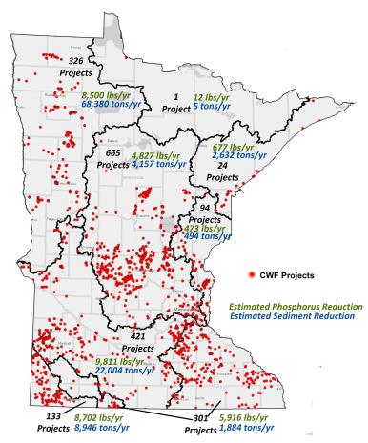

Clean Water Fund investments
FY2010-13:
Notes:
To date, through 550 Clean Water Fund awards, more than 2,472 conservation practices have been installed to reduce critical erosion, stormwater runoff and to keep water on the land. These awards include public and private projects, and involve Minnesotans who voluntarily engage in these activities
Minnesota’s investment of nearly $76M leveraged $59M in partner contributions
Of this, the conservation practices are estimated to reduce 43,195 tons of sediment per year and prevent 45,680 pounds of phosphorus per year from entering Minnesota waters
--------------
In FY2014, 96 applications were funded, totaling over $14M. These projects are estimated to leverage $5.6M, reduce over 18,000 tons of sediment per year and prevent over 18,000 pounds of phosphorus per year from entering Minnesota waters

Slide 9

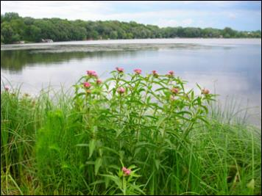
Lake McCarron Protection: Upper Villa Park Volume Reduction and Stormwater Reuse Project
FY 2014 Grant Award: $360,000
100%
80%
60%
40%
20%
10%
0%
39%
Notes:
Capitol WD. Lake McCarron Protection. This purpose of this project is to protect Lake McCarron's by reducing runoff volumes and the pollutants associated with urban stormwater through Best Management Practices, such as bio-retention basin, infiltration systems, and a re-use system to irrigate a community softball field. This project contributes 39% to the overall goal by a 45 TP reduction/yr. (also 50 TSS/yr)

Slide 10
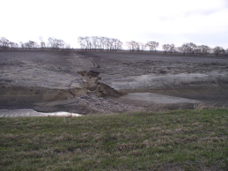
Red River Sediment Reduction Project
FY2014 Grant Award: $165,000
100%
80%
60%
40%
20%
10%
0
18%
Notes:
Wilkin SWCD. Red River Sediment Reduction. The purpose of this project is to install BMPs to repair severe gullies that are contributing to massive sediment loads to impaired Red River. This project contributes 1,200 T sediment reduction – the 18% goal is for the Lower Otter Tail River (also 900 lbs TP)
Application will be attached for you.
see ( c ) for more background on shoreland/ditch buffers.
Picture: An example of a field gully erosion problem. The gull discharges directly into the water resource. The sediment delta is visible in the foreground and the headcutting gully and flowpath within the field extends toward the windbreak in the background.

Slide 11
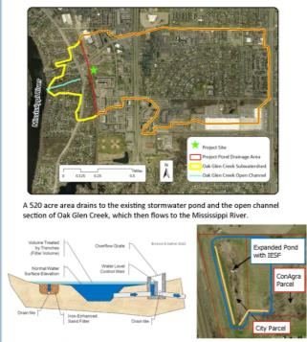
Oak Glen Creek Stormwater Pond Expansion and Iron Enhanced Sand Filter Retrofit
FY 2014 Grant: $517,780
100%
80%
60%
40%
20%
10%
0
33%
Notes:
Anoka CD. Oak Glen Creek Stormwater Pond. The purpose of this project is to expand the stormwater pond and enhance it with an iron sand filter to protect a downstream corridor stabilization and improve the quality of stormwater discharged to the Mississippi River. 24.5 Tons of sediment/yr – this project contributes 33% towards the goal. (also TP at 109 Lbs/yr).
This project is a continuation of a previously funded CWF project that addressed a major ravine downstream of the pond that was contributing a lot of sediment to the Mississippi River. This FY2014 project helps ensure the stability of the ravine by stabilizing upstream flows. The iron sand filter is an enhancement but not the primary driver of the project. This project site is just upstream from the surface water intake near Fridley so was seen has having both positive impacts on drinking water supply as well as addressing the sediment issue in the Mississippi River

Slide 12
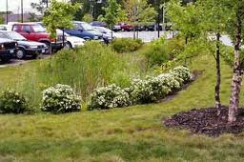
Integrating MIDS into Local Ordinance and Zoning Code
FY 2014 Grant Award: $127,000
Project Goal:
Up to 13 communities in the St. Croix River Basin will adopt ordinance for stormwater quality and volume standards.
Results:
Permanent local permitting processes
Standardized Low Impact Development (LID) stormwater approaches
Notes:
Middle St. Croix WMO
Project Goal :
working hands-on with up to 13 communities in the St. Croix River Basin to adopt ordinance and code revisions to incorporate Minimal Impact Design Standards (MIDS) stormwater quality and volume standards for new development and redevelopment.
Outcomes:
Adopting MIDS will result in permanent local permitting processes that standardize Low Impact Development (LID) stormwater management approaches for new and redevelopment construction projects
PCA led development of MIDS. Cooperation shown with MDH for well sealing and MDA for AGBMP loans being a coordinated part of our grant application process

Slide 13

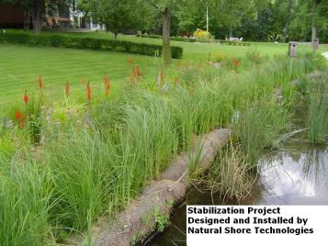
Otter Tail Community Partners Grant
FY 2014 Grant Award: $150,000
Project Goal:
Will provide targeted community groups to go beyond planning and take action to protect their water resources
Results:
6 community partner sub-grants to lake associations with recently completed lake assessment reports
Notes:
Otter Tail County
The purpose of the Community Partners Sub-grant Program is to enable community groups to go beyond planning and take action to protect their water resources.
Lake Associations within Otter Tail County with recently completed lake assessment reports will be the primary audience.
Expected output: 6 community partner sub-grants

Slide 14
Watershed Improvement Tools
0. Data collection/analysis/Plans - to develop remedies
1. Education: awareness to change practices
2. $ Assistance: projects/practices to restore and protect
3. Regulation: to preserve or to restore when development occurs
Notes:
These are the tools, use different ones – but all three are needed eventually. Different Roles for different local organizations.
Ask yourself: Does your watershed have all of these in sufficiently in place? Unlikley, but the goal is to get there and determine who will be responsible for which parts.

Slide 15
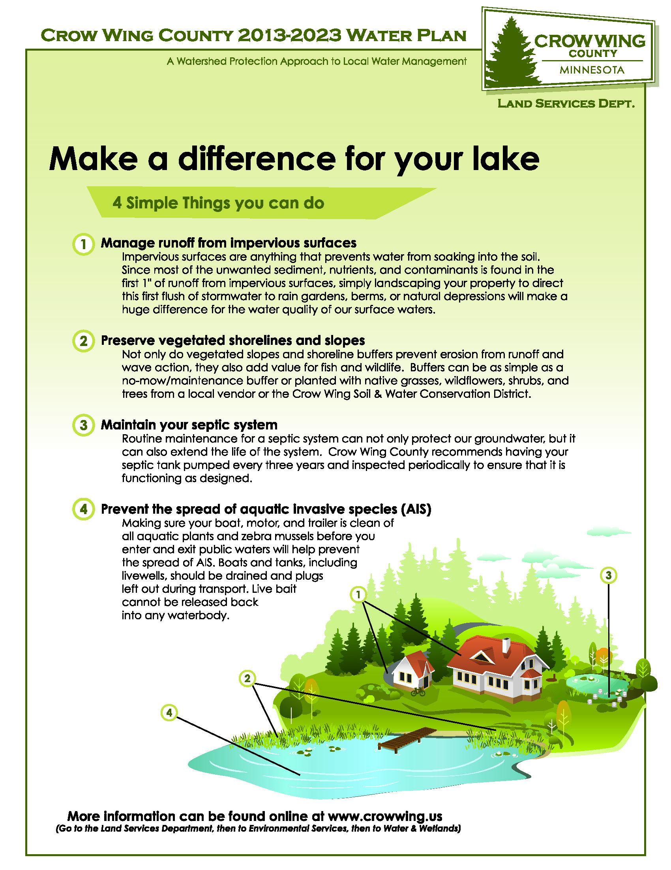
Education
$ Assistance
Regulation
Notes:
These are the tools, use different ones – but all three are needed eventually. Different Roles for different local organizations.
Ask yourself: Does your watershed have all of these in sufficiently in place? Unlikley, but the goal is to get there and determine who will be responsible for which parts.

Slide 16
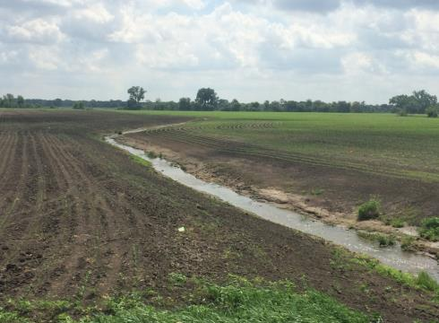
Education
$ Assistance
Regulation ?
Notes:
These are the tools, use different ones – but all three are needed eventually. Different Roles for different local organizations.
Ask yourself: Does your watershed have all of these in sufficiently in place? Unlikley, but the goal is to get there and determine who will be responsible for which parts.

Slide 17
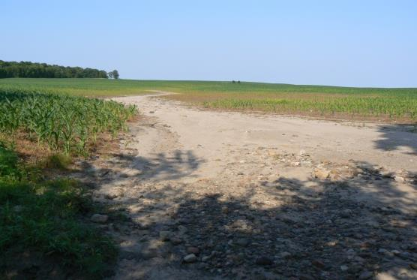
Education
$ Assistance
Notes:
These are the tools, use different ones – but all three are needed eventually. Different Roles for different local organizations.
Ask yourself: Does your watershed have all of these in sufficiently in place? Unlikley, but the goal is to get there and determine who will be responsible for which parts.

Slide 18
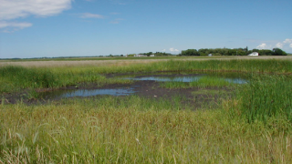
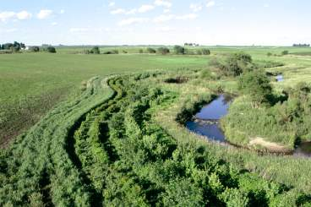
Multiple Benefits
Wetland Restorations & Riparian Buffers
Benefits
Nutrient Reduction
Flood Control
Wildlife and Native Plant Habitats
Pollinator protection
Carbon Sequestration
Recreation
Erosion Control
Nitrate Removal
Biofuel production

Slide 19
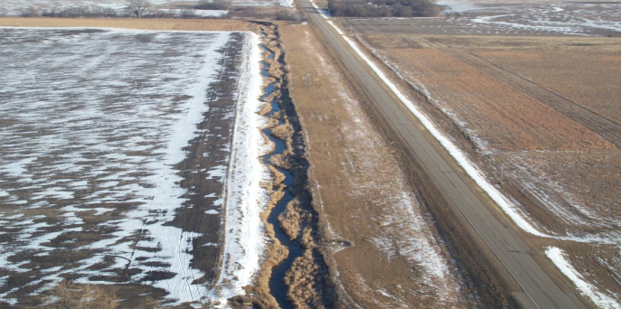
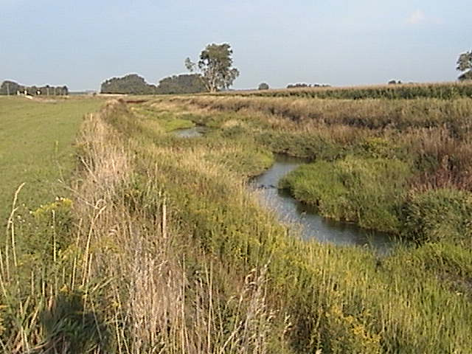
2-Stage Channel – Swift County JD #8

Slide 20
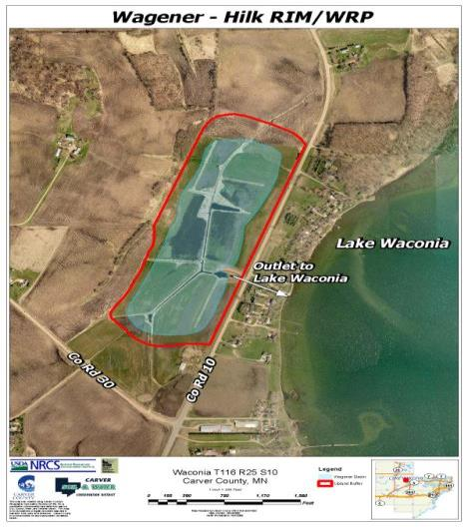

Re-invest In Minnesota (RIM) Reserve
USGS, July 2008
EFFECTS OF AGRICULTURAL LAND RETIREMENT IN THE MINNESOTA RIVER BASIN

Slide 21
Dalen Coulee, Clay & Norman Counties
Wild Rice Watershed District
Wetland Restoration with flood control outlet
RIM Conservation Easement
Notes:
Clay/Norman Counties
Dalen Coulee Project (RIM)
Ducks Unlimited monies were used to create deeper water habitat for waterfowl.

Slide 22
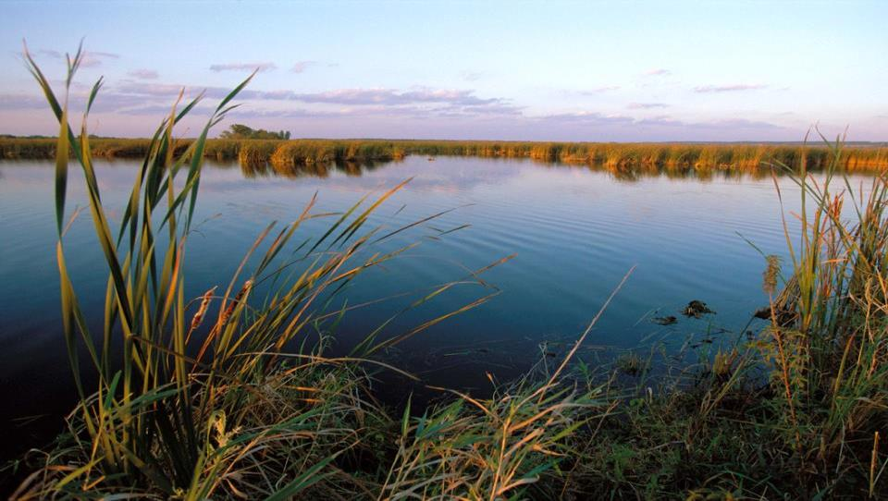
Wetlands Policy
NE Minnesota Mitigation Options
Corps of Engineers/NRCS coordination
EPA Rule - WOTUS

Slide 23
Questions?
www.bwsr.state.mn.us
john.jaschke@state.mn.us

